Slide 1

#TEAM-DISENTANGLEMENT
Silvia Seidlitz, Jan Sellner, Heiko Oppel

Slide 2
01
Exploring The Data
What can we expect from the data
02
Research Question 1
Is it possible to disentangle volcanic and solar forcing by region selection?
03
Research Question 2
Is it possible to boost the prediction of volcanic and solar forcing by relying solely on the identified regions?
Agenda

Slide 3
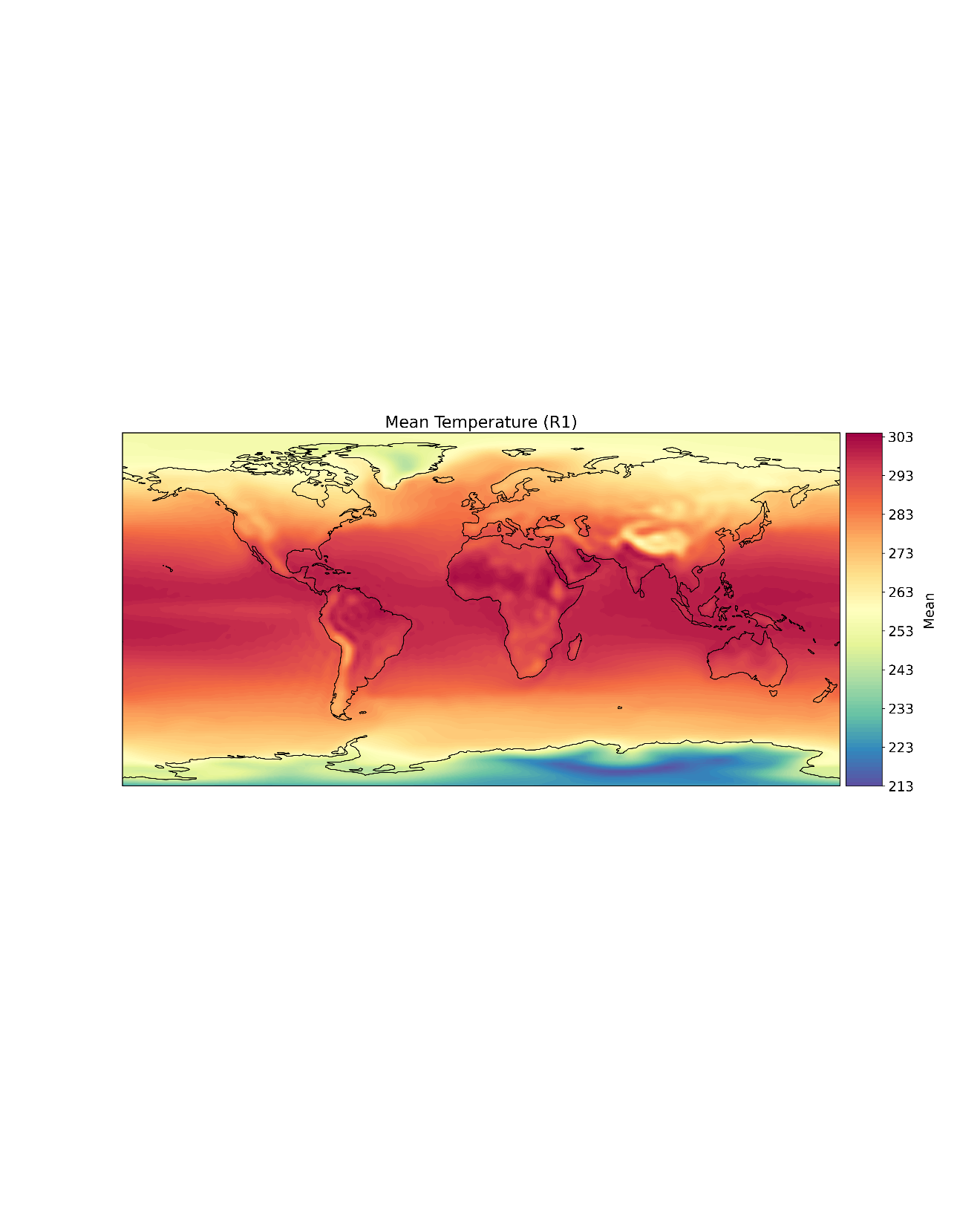
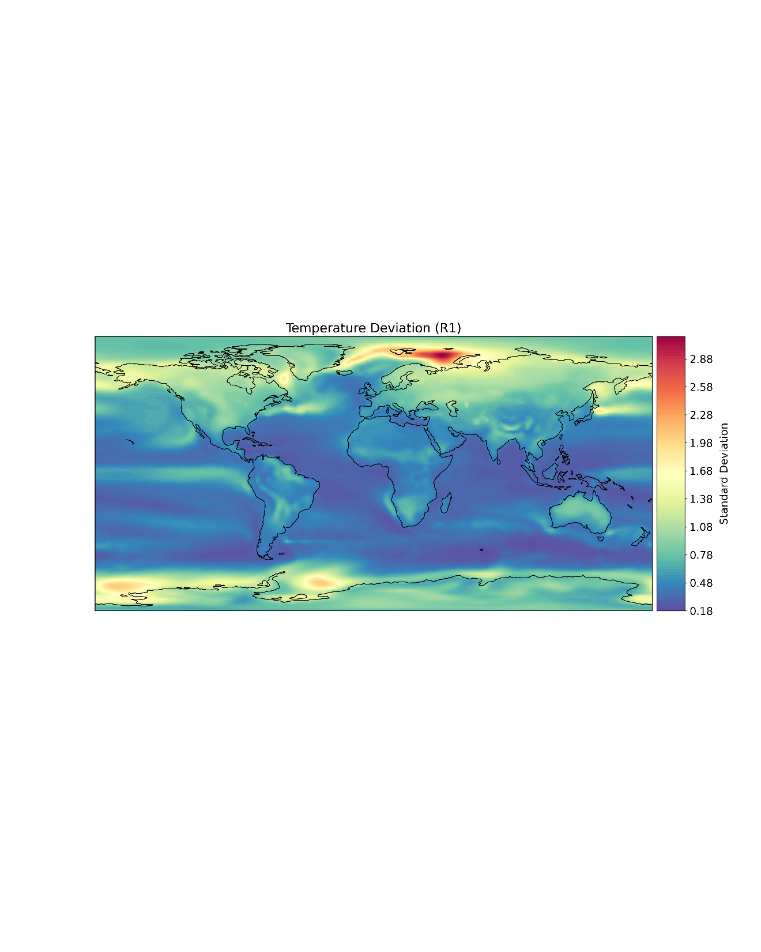
Exploring The Data
Temperature variation
Mean temperature from simulation results R1 over the whole simulation time
Region-dependent temperature
Standard deviation from simulation results R1 over the whole simulation time
Highest temperature variations around the north pole
Silvia Seidlitz, Jan Sellner, Heiko Oppel HIDA Datathon 01

Slide 4
Research Question 1
RQ1: Can we disentangle volcanic and solar forcing by region selection?
Hypothesis: We can disentangle volcanic and solar forcing through region selection
Silvia Seidlitz, Jan Sellner, Heiko Oppel HIDA Datathon 02

Slide 5
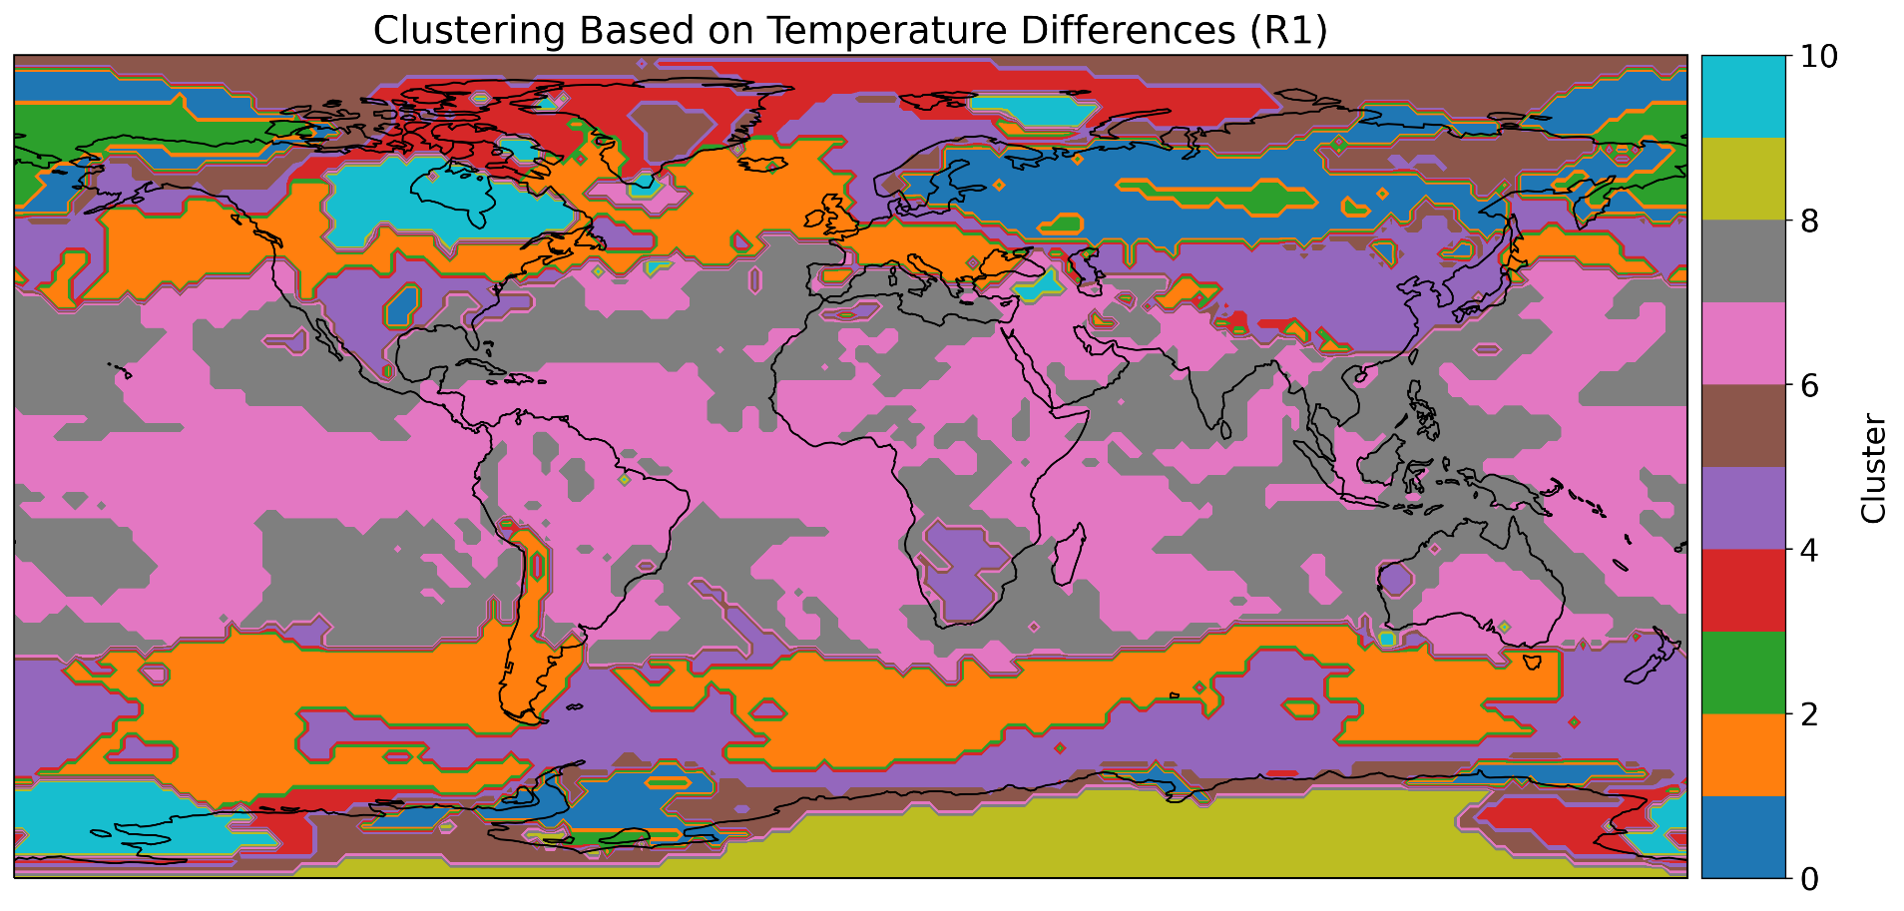
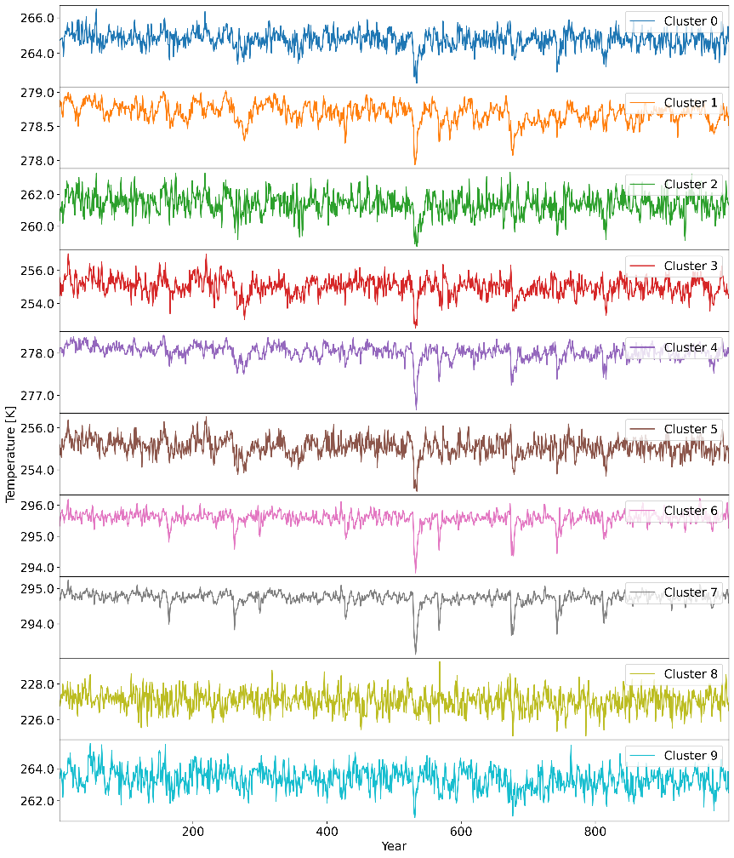
Research Question 1
RQ1.1: Disentanglement based on temperature time series data
Selection of regions via k-means clustering based on the temperature differences T(yr)-T(yr-1) time series
Silvia Seidlitz, Jan Sellner, Heiko Oppel HIDA Datathon 03

Slide 6
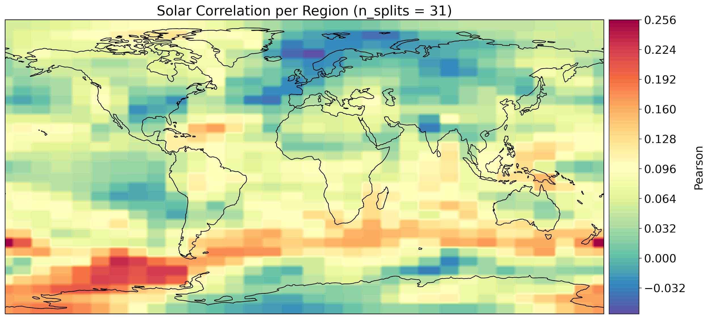
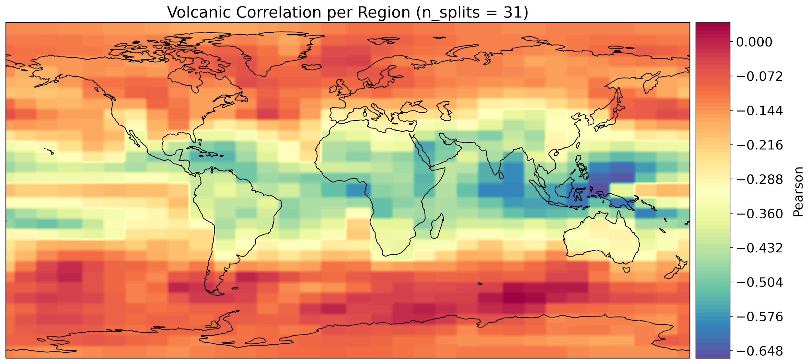
Research Question 1
RQ 1.2: Disentanglement including prior knowledge of volcanic/solar activity
Pearson correleation coefficient to disentangle volcanic and solar activity.
Silvia Seidlitz, Jan Sellner, Heiko Oppel HIDA Datathon 04

Slide 7
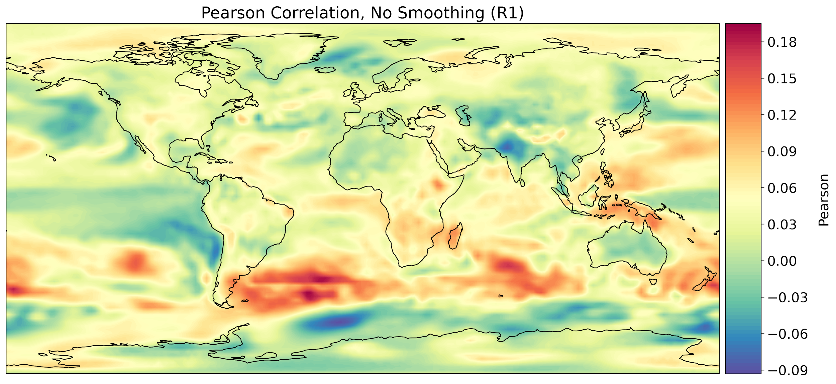
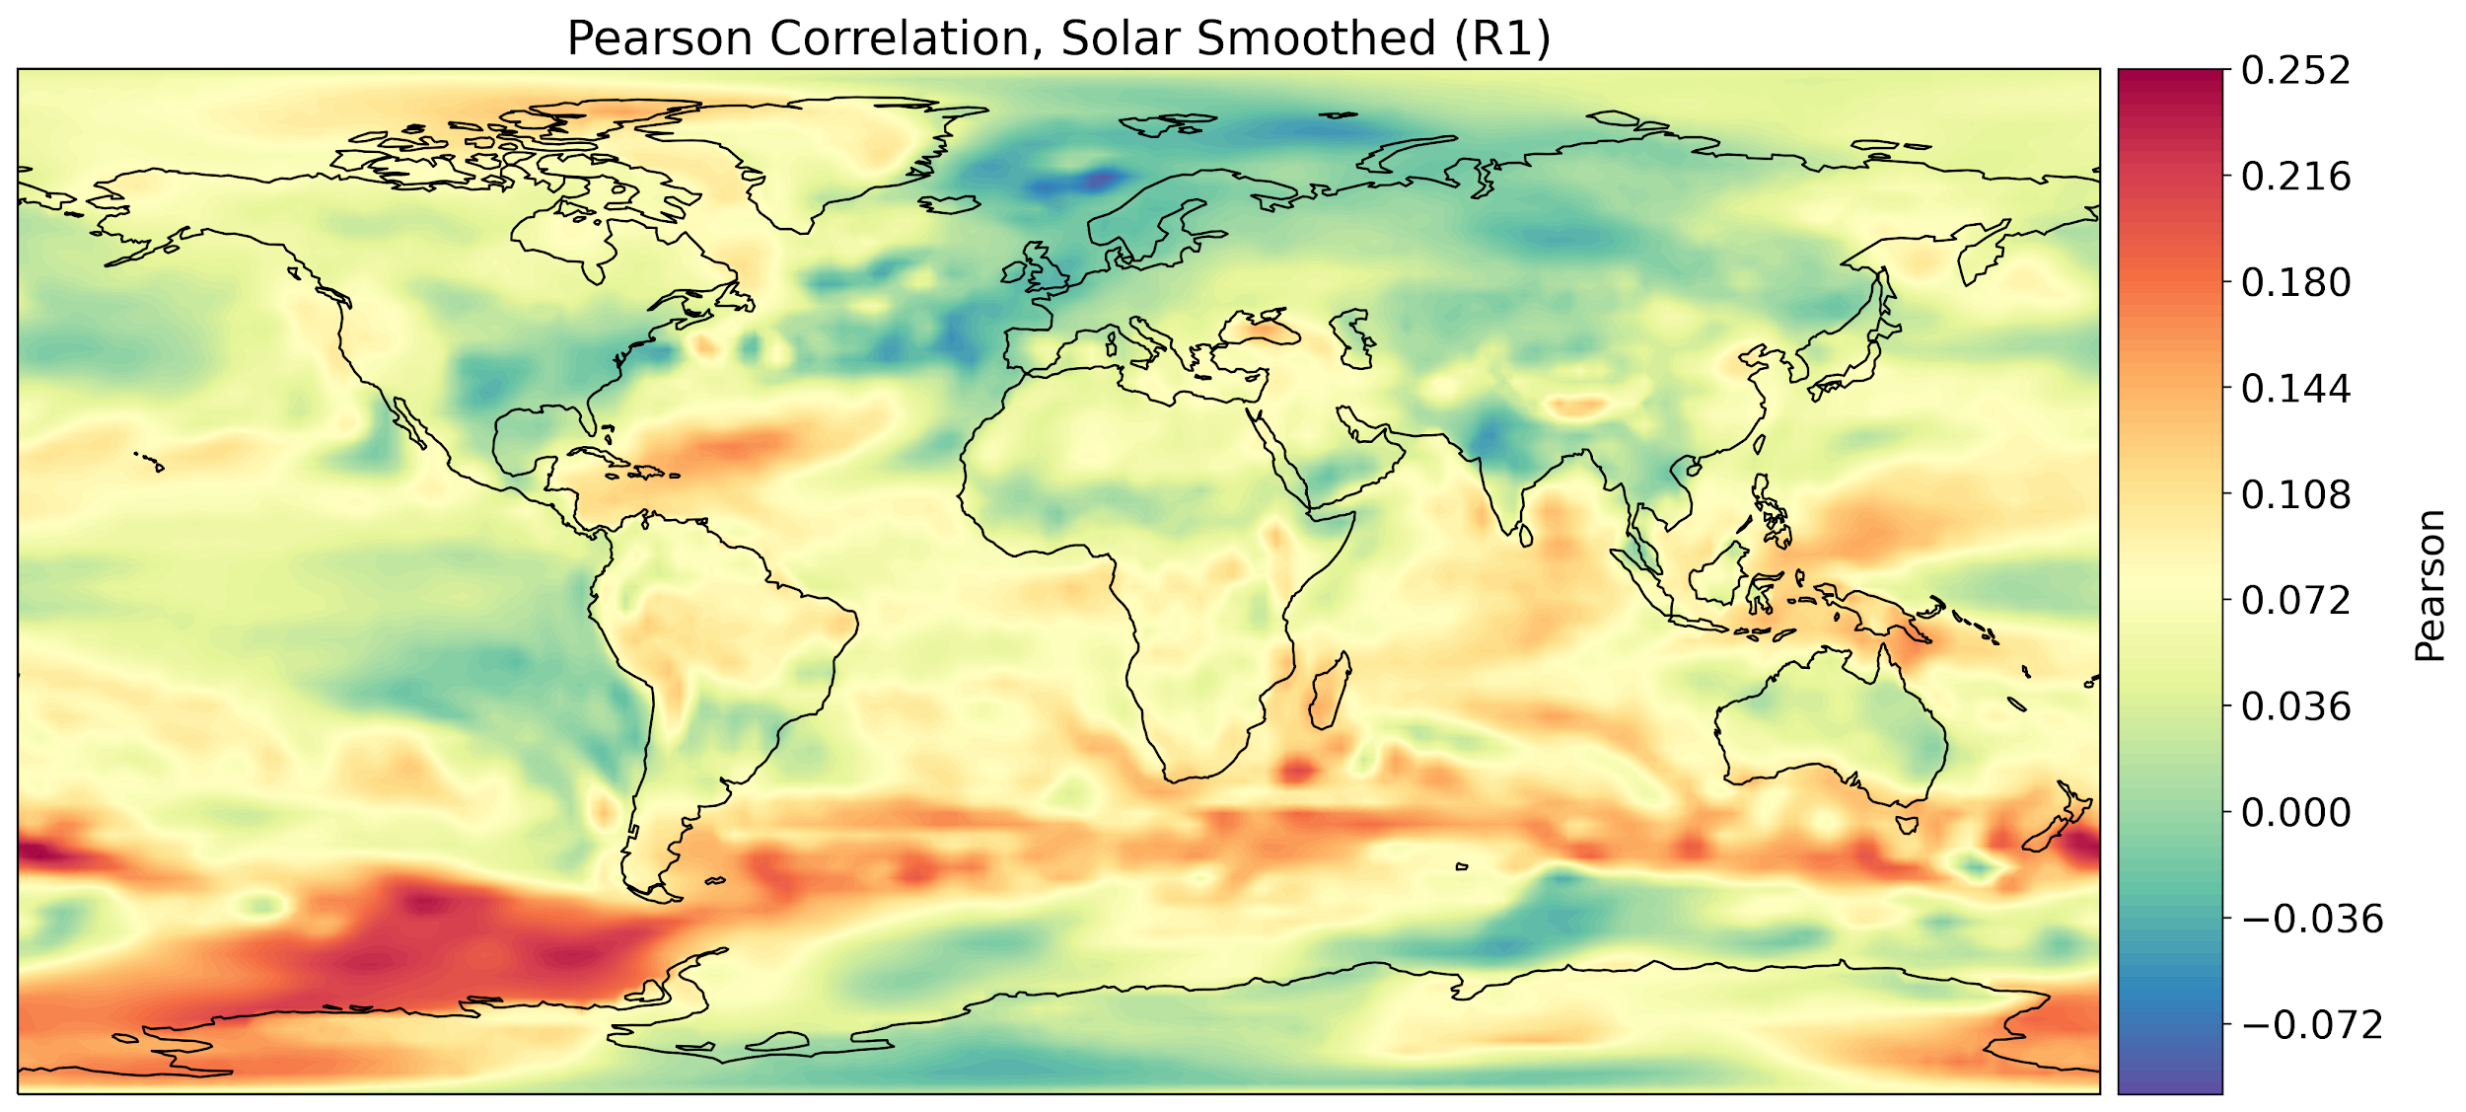
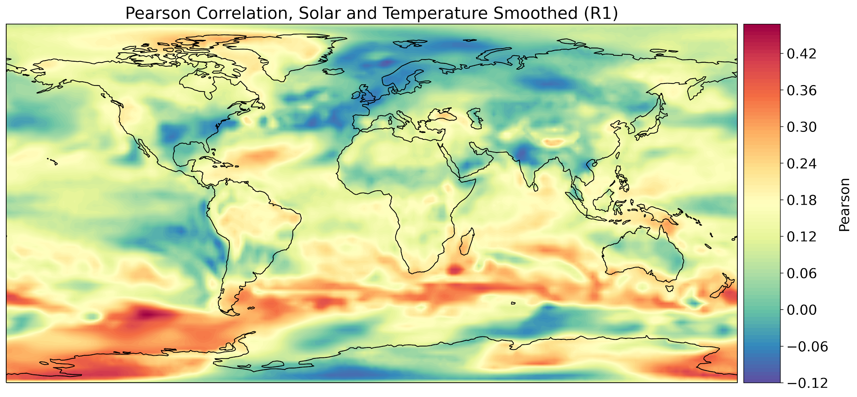
Research Question 1
RQ 1.2: Disentanglement including prior knowledge of volcanic/solar activity
Impact of a filter for disentangling solar activity. Measured by pearson correlation coefficient between i) Solar force and average temperature
ii) filtered solar force using a butterworth filter of 8th order and average temperature
iii) filtered solar force and average temperature using a butterworth filter of 8th order
(i)
(ii)
(iii)
The filter method changes the regional areas with high correlation.
Silvia Seidlitz, Jan Sellner, Heiko Oppel HIDA Datathon 05

Slide 8
Research Question 1
RQ2: Selecting the appropriate regions, can we detect volcanic activities / regress solar activities?
Hypothesis: we can detect volcanic activities as outliers in the temperature time series data of a selected region
Silvia Seidlitz, Jan Sellner, Heiko Oppel HIDA Datathon 02

Slide 9
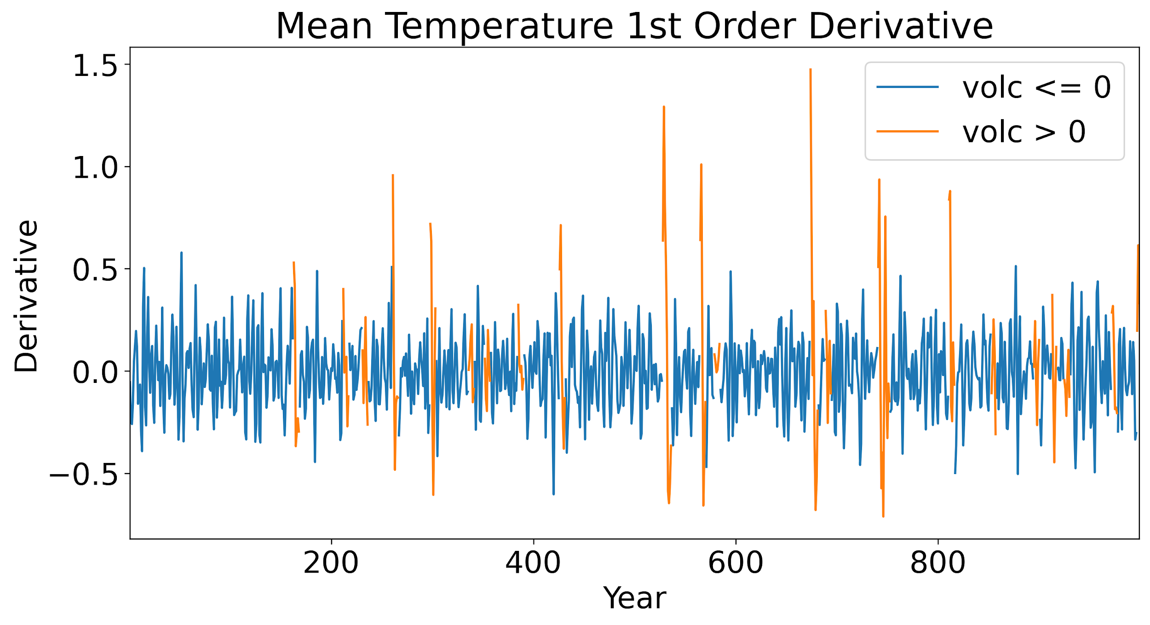
Research Question 1
RQ 2.1: Detecting volcanic activities as outliers
Approach:
Selecting clusters 6 & 7
Generating the first derivative of the temperature time series
Outlier detection via Isolation Forest
Results:
 |  | Predicted
 |  | out | in
True | out | 26 | 112
 | in | 4 | 857
Silvia Seidlitz, Jan Sellner, Heiko Oppel HIDA Datathon 02

Slide 10
Research Question 1
RQ 2.2: Can we expect a correlation based on Pearson?
Experiment to check, whether Pearson correlation coefficient is actually meaningful:
 | GT & temperature data | GT & 1000 simulated temperature time series (based on an autoregressive model AR(1))
GT = TSI | 0.42 | 0.40
GT = AOD | 0.68 | 0.56
Silvia Seidlitz, Jan Sellner, Heiko Oppel HIDA Datathon 02

Slide 11
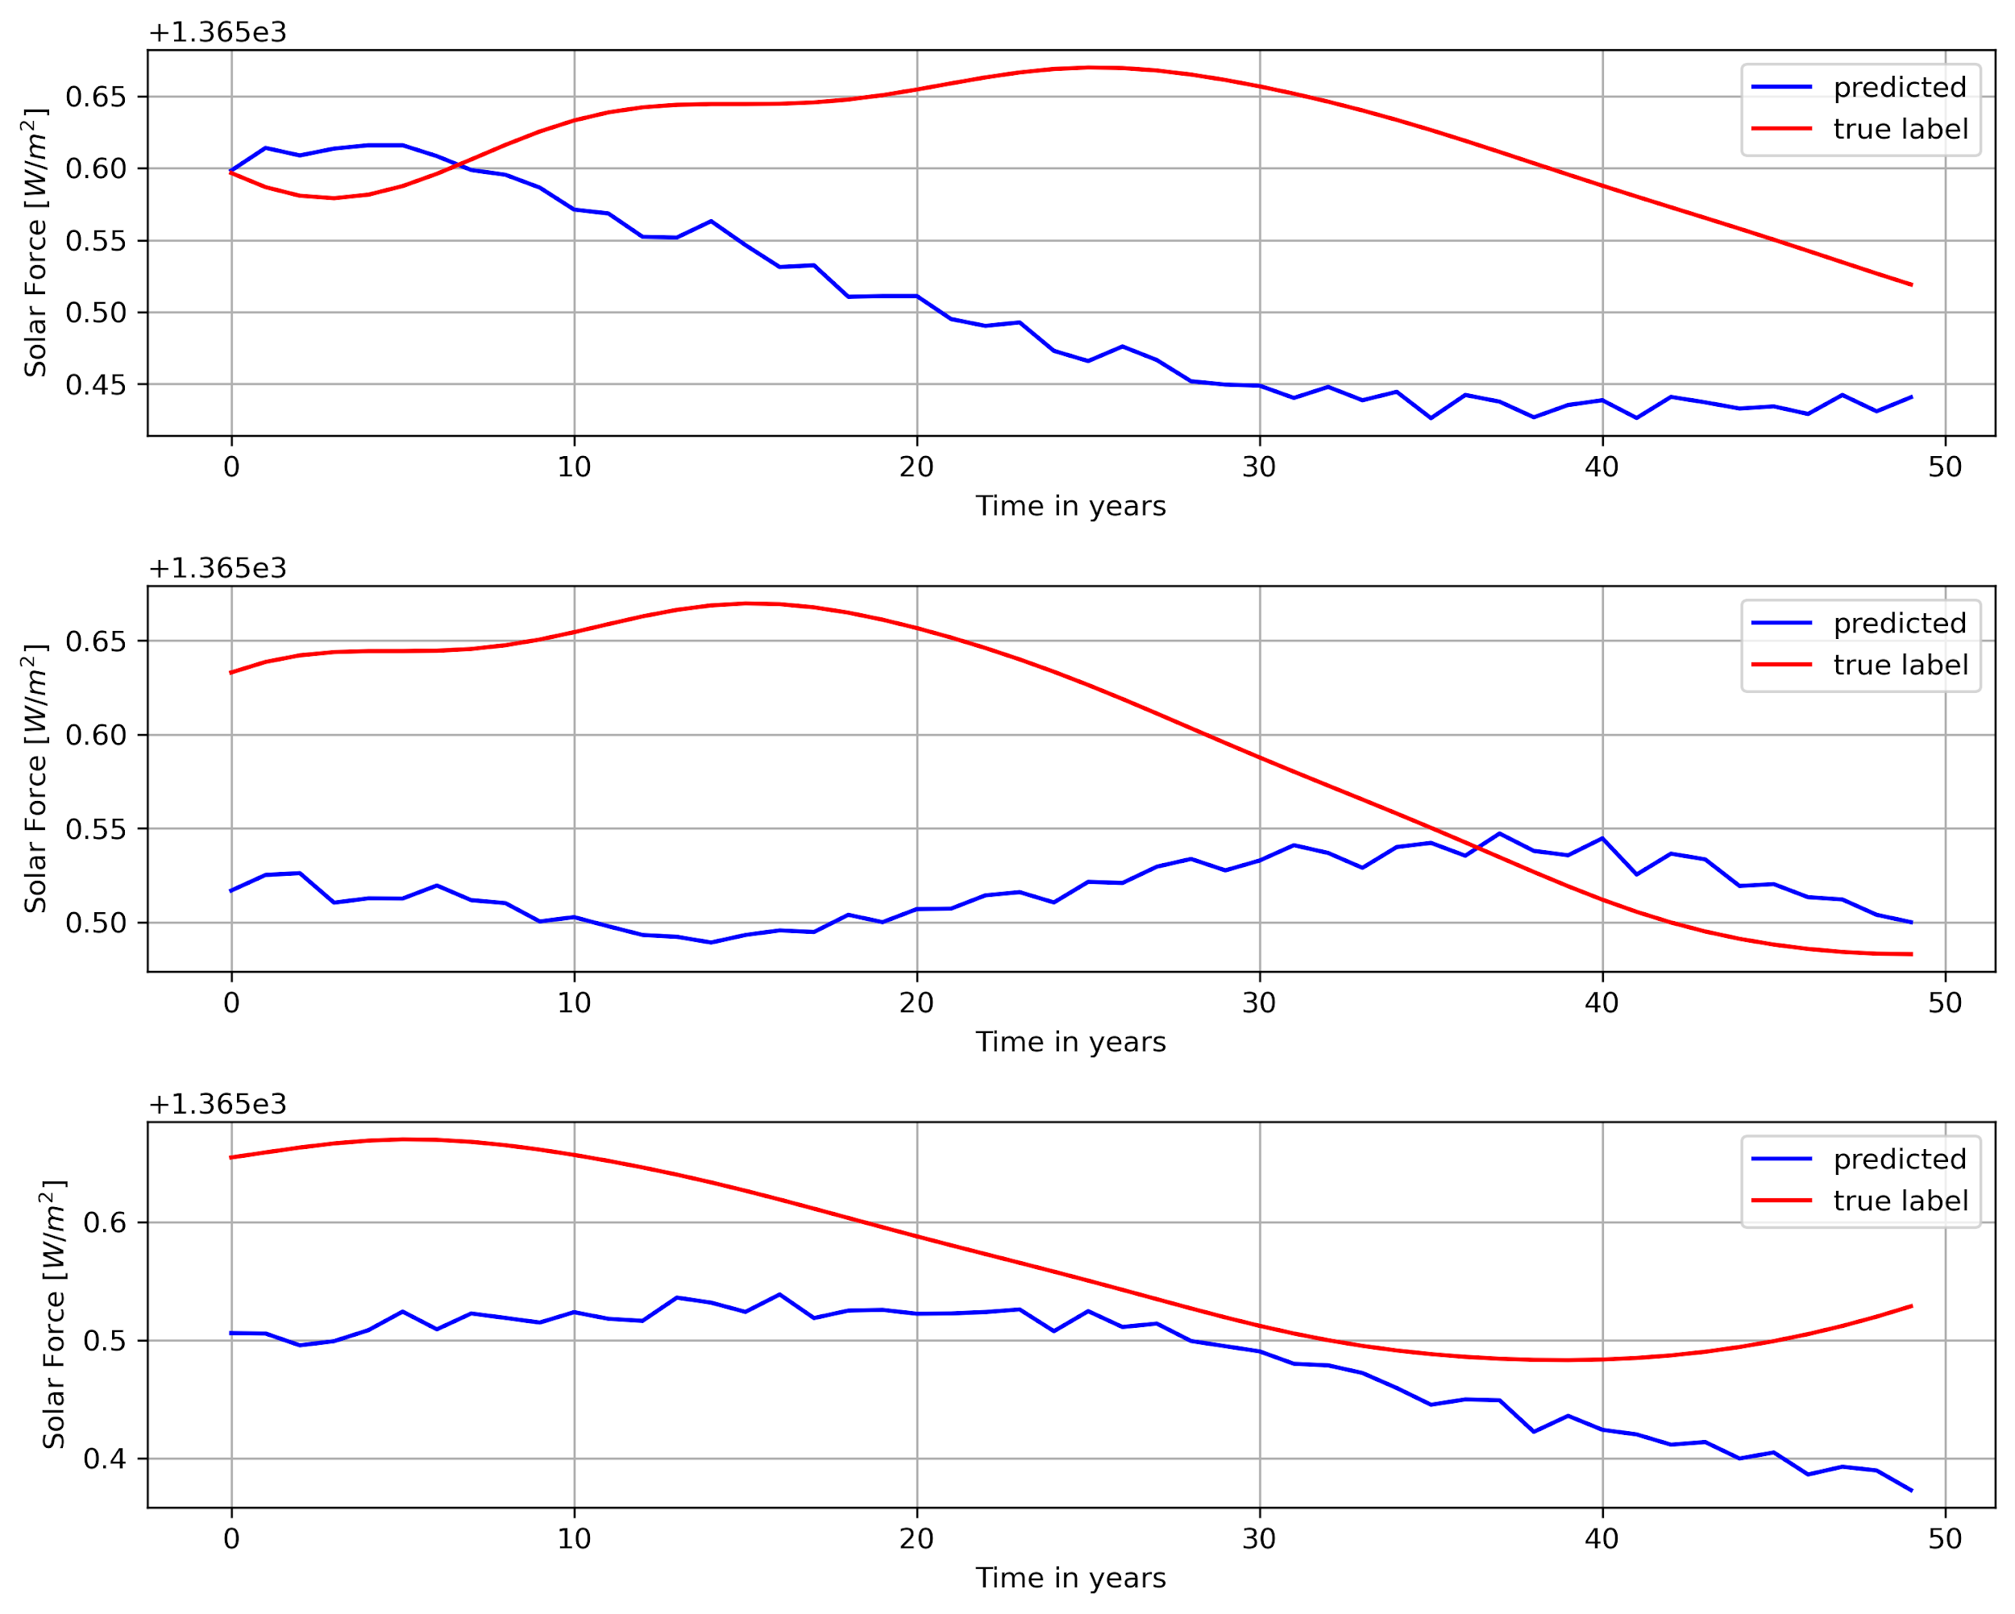
Research Question 1
RQ 2.3: Predicting solar force using CNN
Approach:
Selection progress of input data based on the disentangled high correlated & filtered solar forces between the average temperature
3-layered CNN designed for automatic feature engineering and a two layered dense network architecture for solving the regression task of predicting 50 years of solar force
Result:
Low correlation between input and output data results in low correlation between predicted and true curves
Silvia Seidlitz, Jan Sellner, Heiko Oppel HIDA Datathon 02

Slide 12
Summary
Regions to disentangle the impact of volcanic and solar forcing could be identified
Phases of volcanic activity were detected using Isolation Forest on the first derivative of temperature data in a selected region
Disentangled regions with highest correlation coefficient between solar forces and temperature were not enough to lead to acceptable results

